Slide 1



AVIGHNA DEVELOPERS
A FASTEST GROWING REAL ESTATE COMPANY

Slide 2
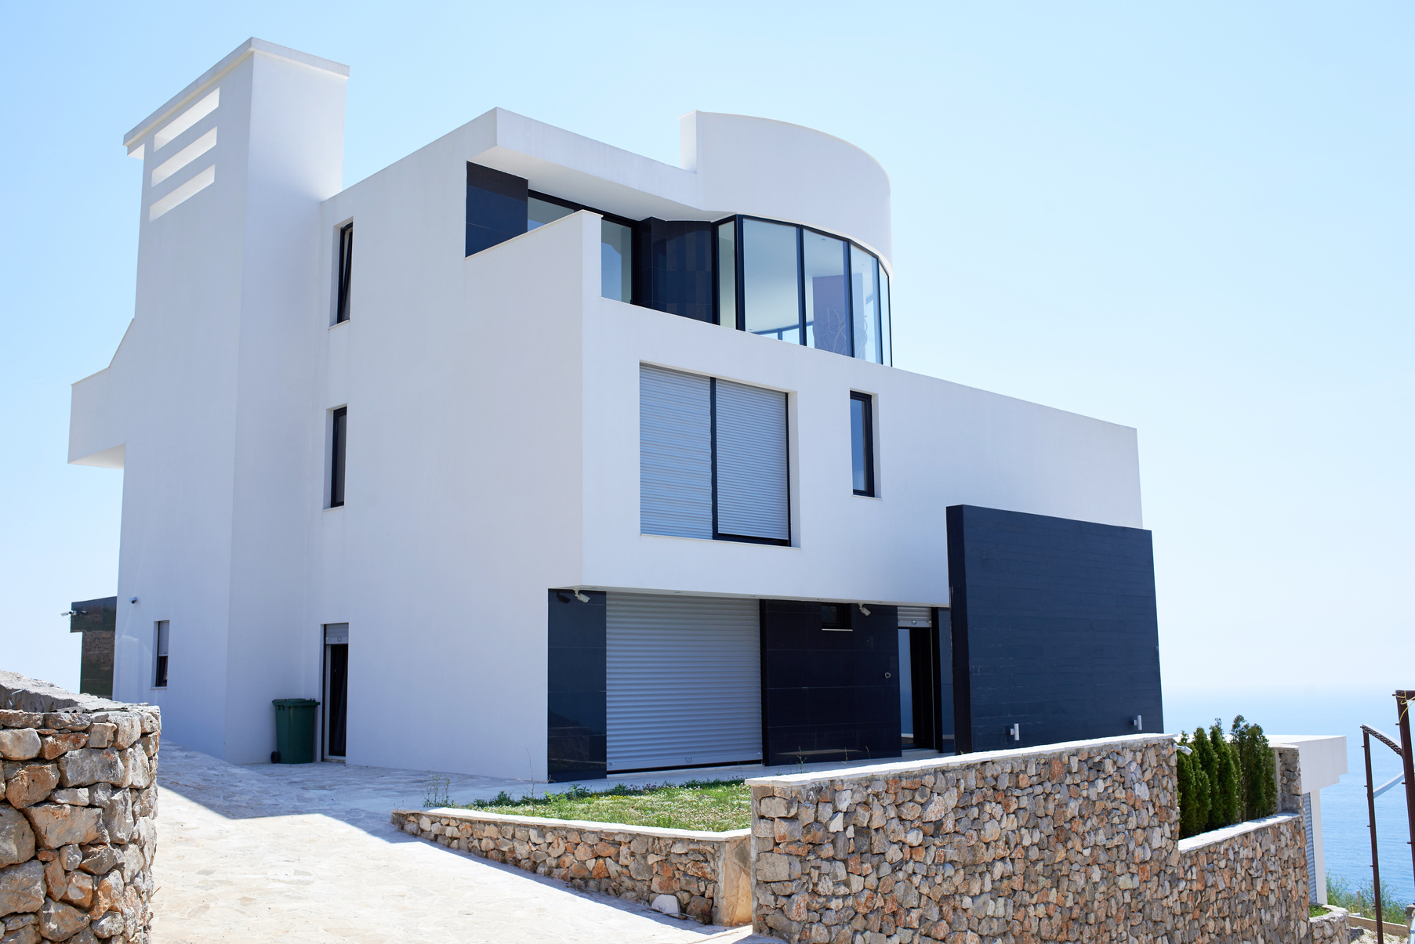
About Us
AVIGHNA DEVELOPER’S, A FASTEST GROWING REAL ESTATE COMPANY IN PUNE, HAVING DEVELOPMENT PROJECTS IN HADAPSAR, PUNE AND MAHABALESHWAR, MAHARASHTRA.

Slide 3
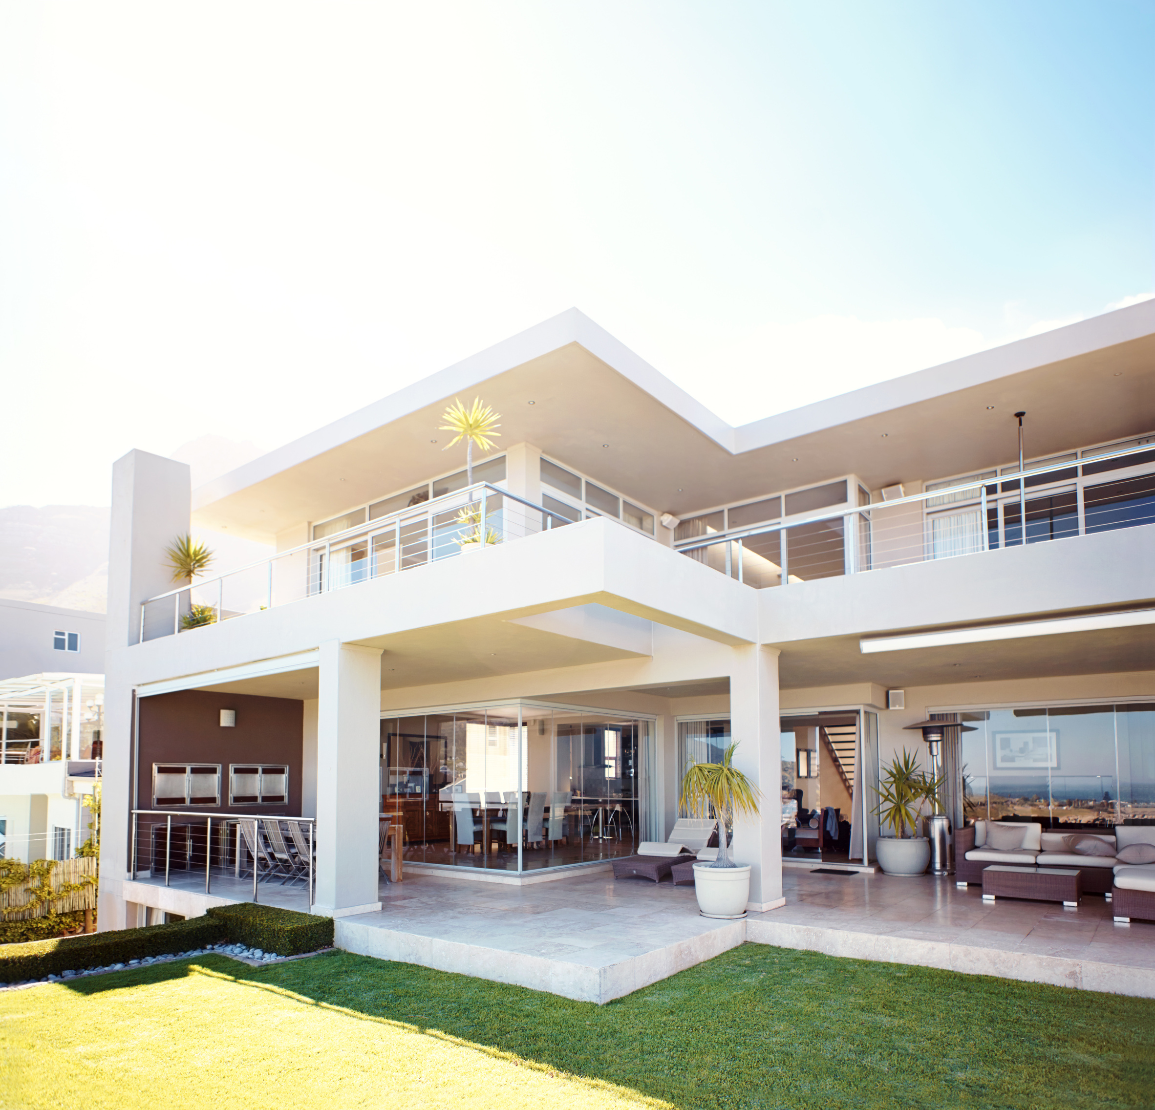
Management Team
Chairman
Rahul Gaikwad
Director
Amit Kumar Ojha
Project Manager
Sales Head
Procurement
Devanand Bansode
Nilesh Choudhary
Vishal Jadhav

Slide 4
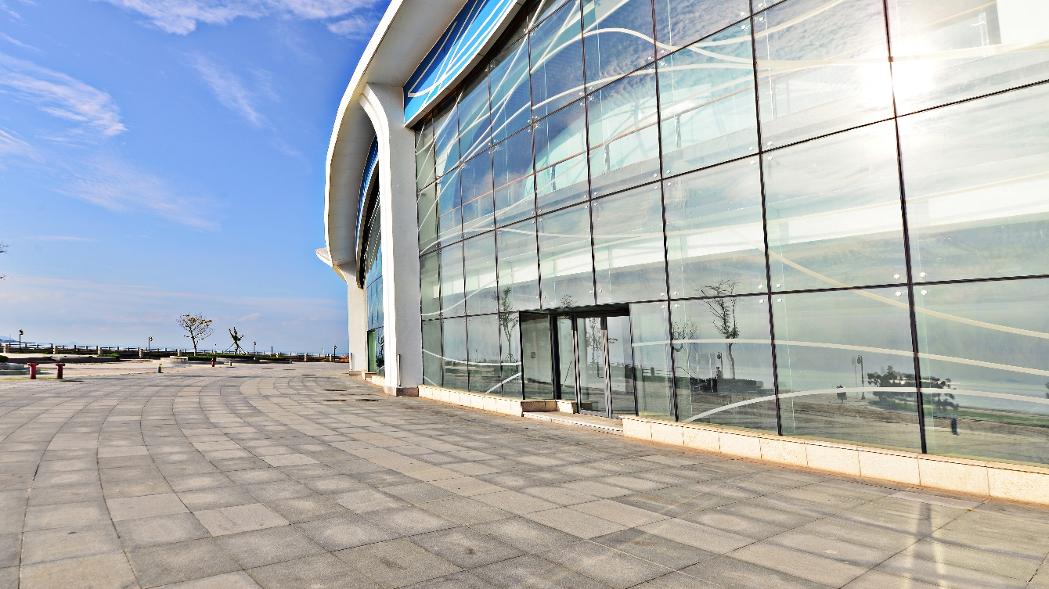

Company Vision
To become the leading construction firm, while delivering projects that consistently exceed international standards and provide exceptional customer satisfaction..

Slide 5
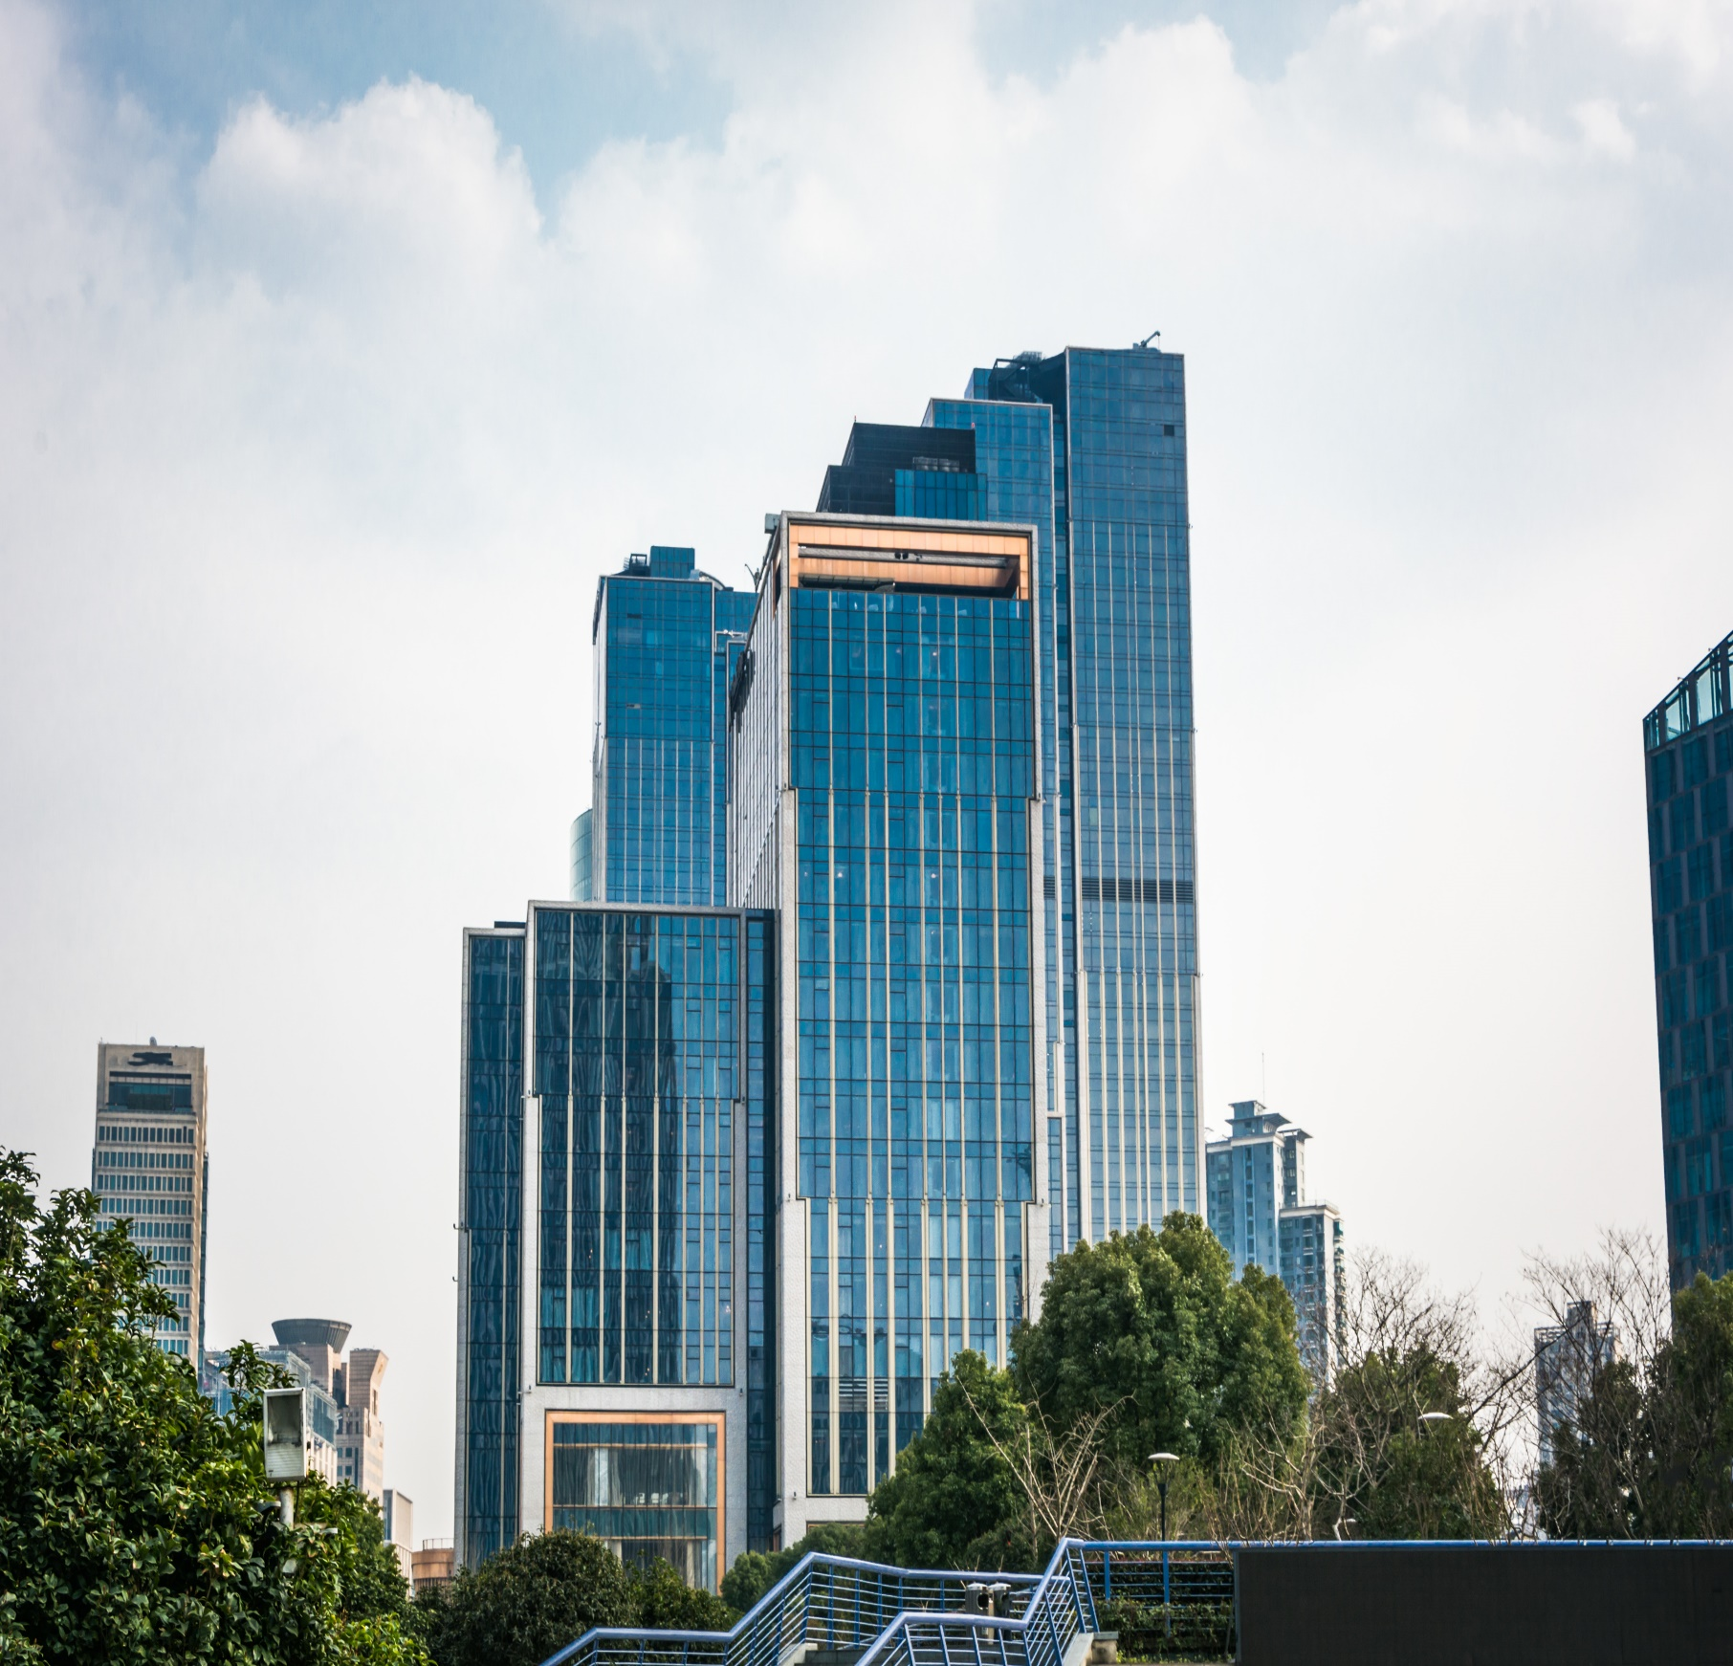
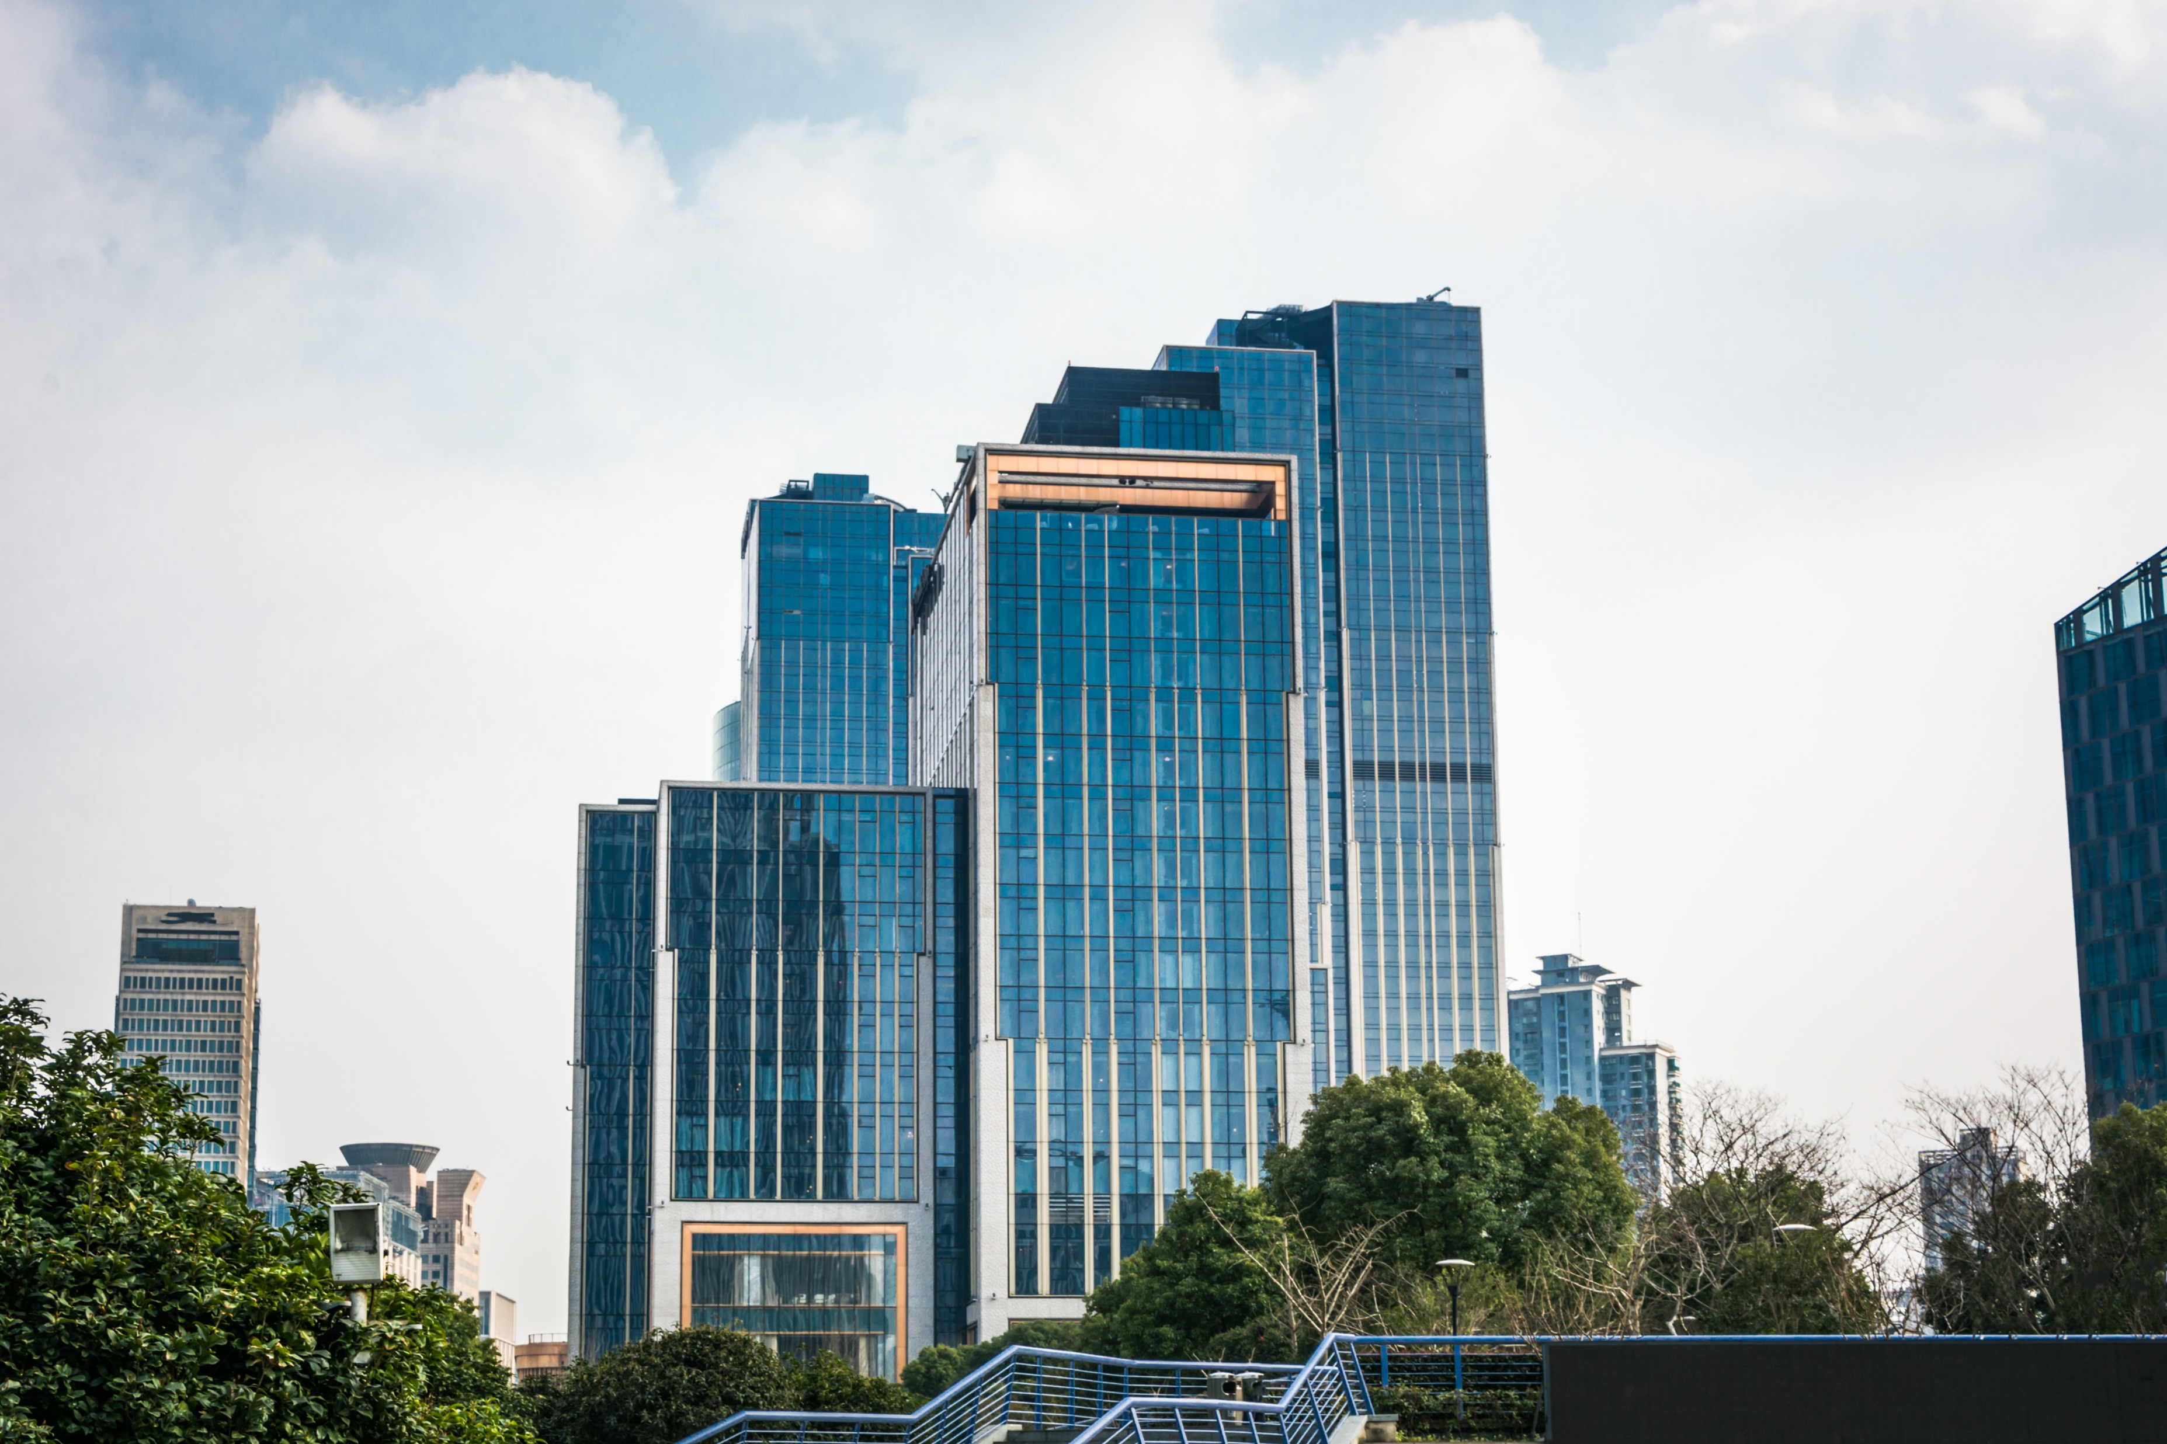
Company Mission
To become the most preferred choice for customers by attaining excellence in quality and timely completed value-added projects.
To provide the highest level of service in the construction industry while offering superior craftsmanship to every project, we handle.

Slide 6

Company Target
To grow our reach in Pune by opening new locations in specific neighborhoods with a high demand for our services. This will allow us to better serve our customers and grow our business.

Slide 7
Cr.
Turn over chart
Year | Cr
2016 | 7
2017 | 9
2018 | 11.20
2019 | 13.50
2020 | 15.80
2021 | 14.50
2022 | 16.50
20
15
Company’s Annual Turn Over
10
5
0
2016
2017
2018
2019
2020
2021
2022
Yr

Slide 8
2019 Turn over
2022 Turn over
TIMELY DELIVERY OF THE VARIOUS PROJECTS INITIATED IN MULTI LOCATION AT KESHAV NAGAR AND MANJARI.
SINGLE REAL ESTATE DEVELOPMENT PROJECT.
22.4%
27.4%
2020 Turn over
MULTIPLE REAL ESTATE PROJECT AT HADAPSAR.
26.2%
2021 Turn over
24%
MULTIPLE REAL ESTATE PROJECT AT MULTIPLE LOCATIONS IN PUNE.

Slide 9

Company SWOT
STRENGTH
HIGH EFFICIENCY
SKILLED AND EXPERIENCED STAFF
EXCELLENT CUSTOMER SERVICE
EXPERIENCED SUBCONTRACTORS
WEAKNESS
HIGH COST
OPPORTUNITY
THREADS
ADDING NEW DIVISION IN THE COMPANY
FOLLOWING LATEST TREND
WORKING ON FUTURE PROJECTS
LOSING CLEINTS TO OTHER COMPANIES
UNCERTAIN ECONOMIC CONDITIONS

Slide 10
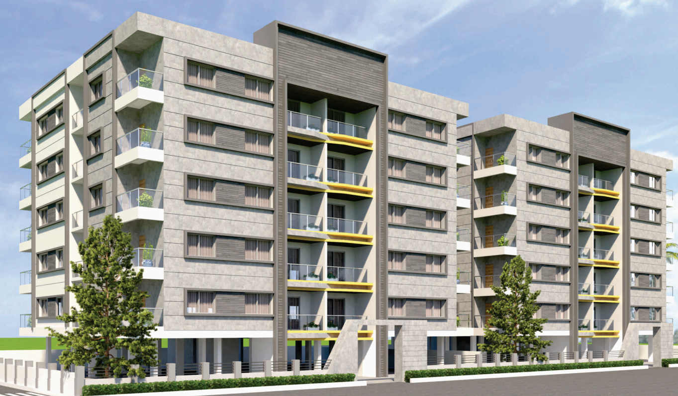
Projects in Pune
AVIGHNA
Realtors
AVIGHNA
Developers
Vimal Park (20 Flats) - At Keshav Nagar
Iris (40 Flats)- at Manjari Budruk
PRABHASH Construction
PRABHASH
Landmark
Oasis ( 25 Flats ) - At Manjari Budruk
Marigold ( 35 Flats ) - at Manjari Budruk with Commercial Spaces
AVIGHNA DEVELOPERS
Avighna
Buildcon
Carnation (180 flats) - at Manjari Budruk

Slide 11

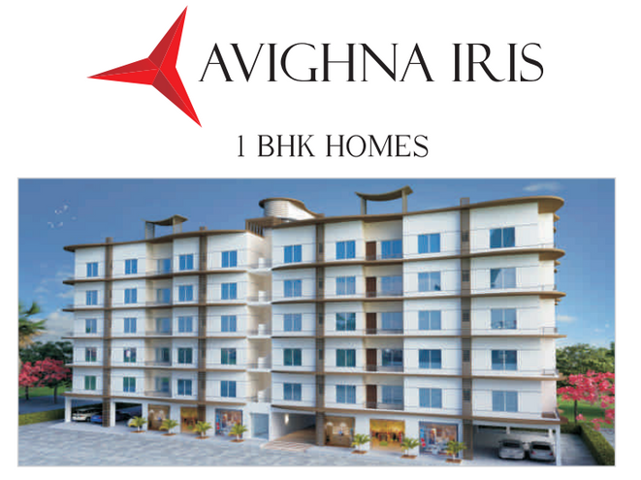

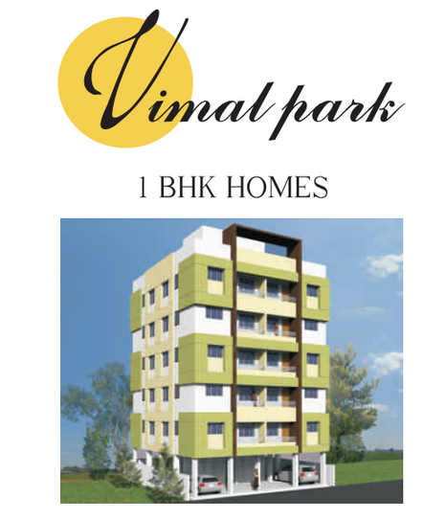
Completed Projects
AVIGHNA DEVELOPERS
We have given possessions to 300+ families up till now

Slide 12

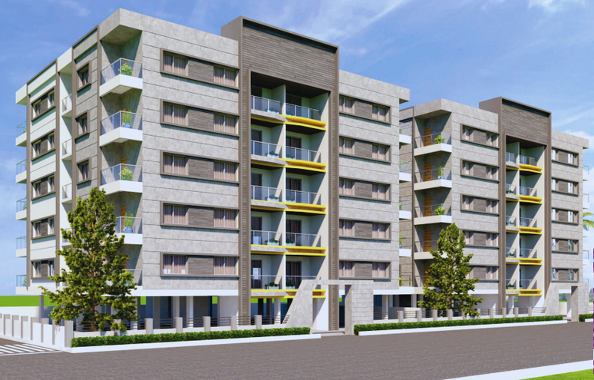
1 & 2 BHK Flat
at Manjari Pune
Ongoing Project

Slide 13
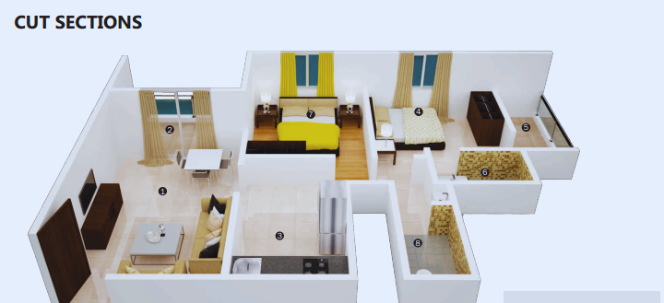
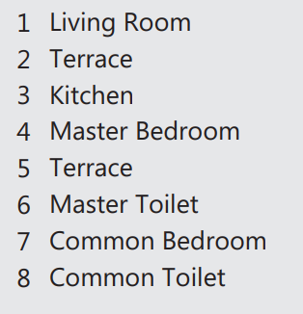
2 BHK

Slide 14
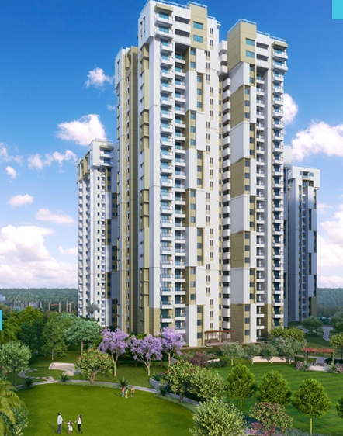
Amenities
Upcomming Project - 01
2 Swimming Pool
Children Swimming Pool
Gym
BasketBall Court
2 Club House
Garden
Yoga Room
Tennis Court
Senior Citizens Sit Out
Jogging Track
AT KUNJIRWADI
BUILDING GREENEST TOWNSHIP
AT KUNJIRWADI
Near by facility residence:
2 km River view Project
2 km Railway station
500 MTR Hospital
500 MTR 3 School
Nearby - 150 MTR Solapur - Pune Highway
Close to the pmpml bus stop.
AVIGHNA
DEVELOPERS

Slide 15
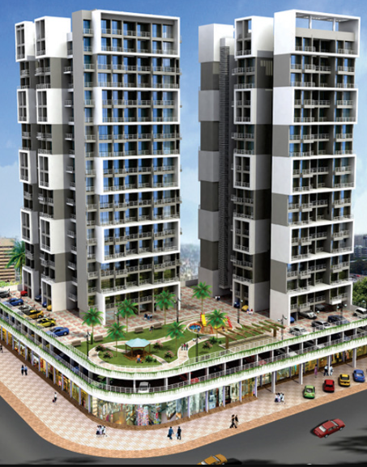
Upcomming Project -02
Amenities
Gym
Club House
Table Tennis Court
Senior Citizens Sit Out
AT KESHAV NAGAR
BUILDING
AT KESHAV NAGAR
Near by facility residence:
3 km Amanora & season mall
Close to the Pmpml Bus stop
500 MTR hospital
200 MTR orbis school
3 km kharadi & magarpatta IT Park.
AVIGHNA DEVELOPERS

Slide 16
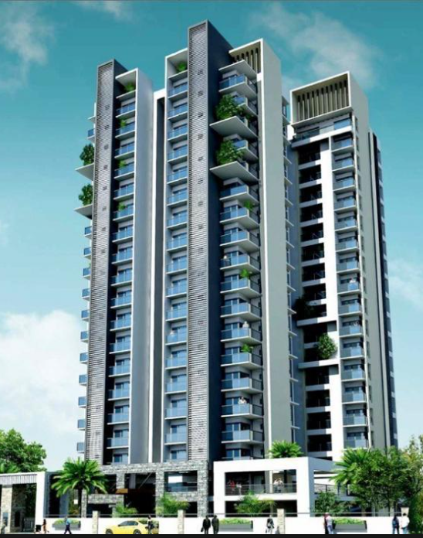
Amenities
Upcomming Project - 03
Gym
Club House
Table Tennis Court
Senior Citizens Sit Out
AT HANDEWADI
BUILDING
AT HANDEWADI
Near by facility residence:
Close to the pmpml bus stop
500 MTR hospital
500 MTR school & college
500 MTR katraj by-pass highway
3 km Hadapsar
AVIGHNA
DEVELOPERS

Slide 17
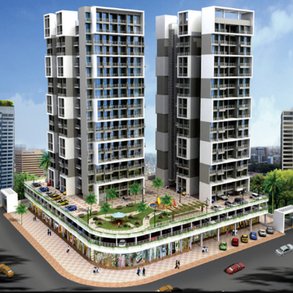


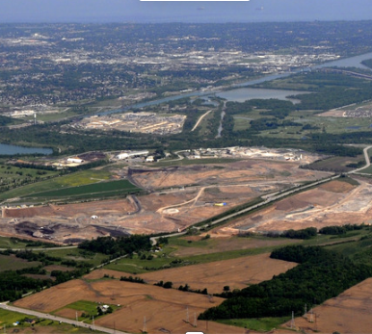
Projects all over Pune and Maharashtra
KESHAV NAGAR
HANDEWADI
Different Amenities at Cheaper Cost, Located at the Center from Kharadi and Magarpatta
Well-known Gated Community in Handewadi with premium Amenities
AVIGHNA DEVELOPERS
MAHABALESHWAR
KUNJIRWADI
Residential land / Plots in
Mahabaleshwar
Luxury Amenities, Located in Neighbourhood of Renowned Developers and Townships

Slide 18
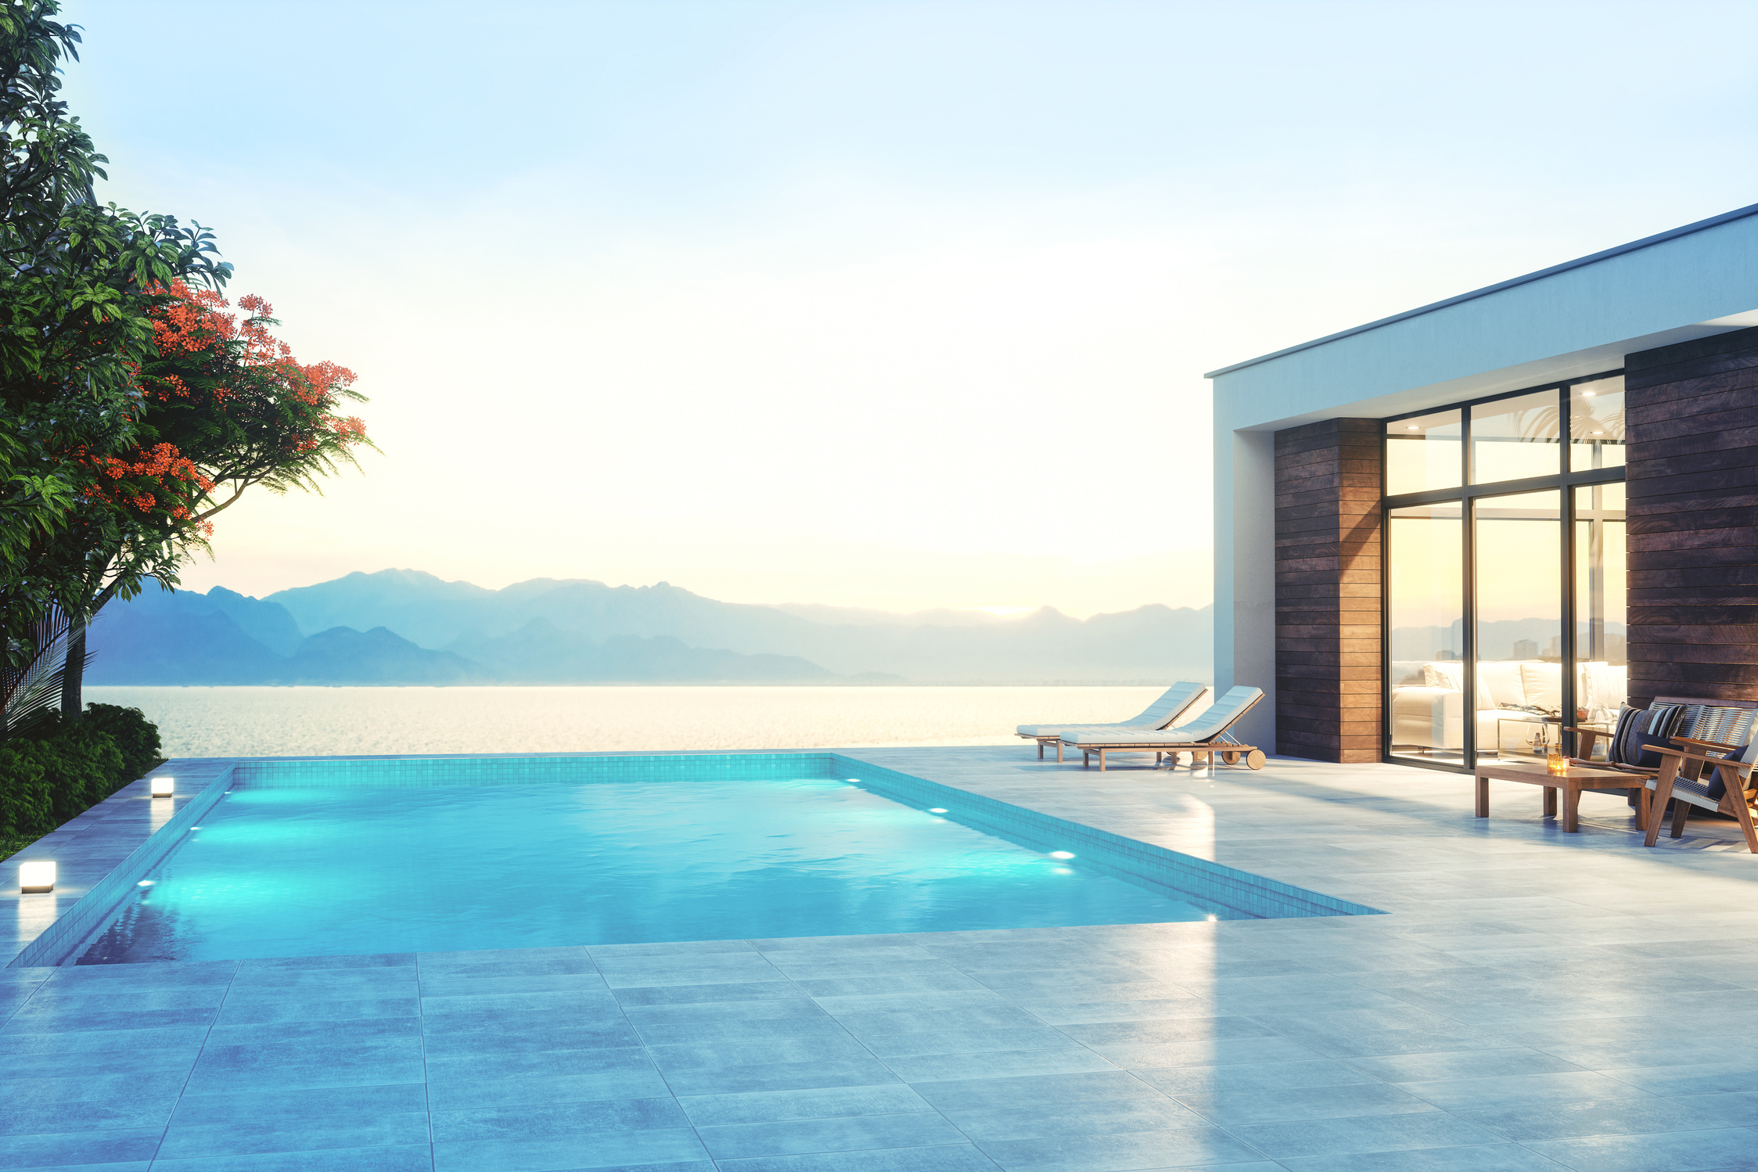


Contact Us
Address - office no. 404, Gandharva Capital, Bhosale Nagar, Hadapsar Pune - 411028
avighna.developers01@gmail.com
+917499400853

Slide 19

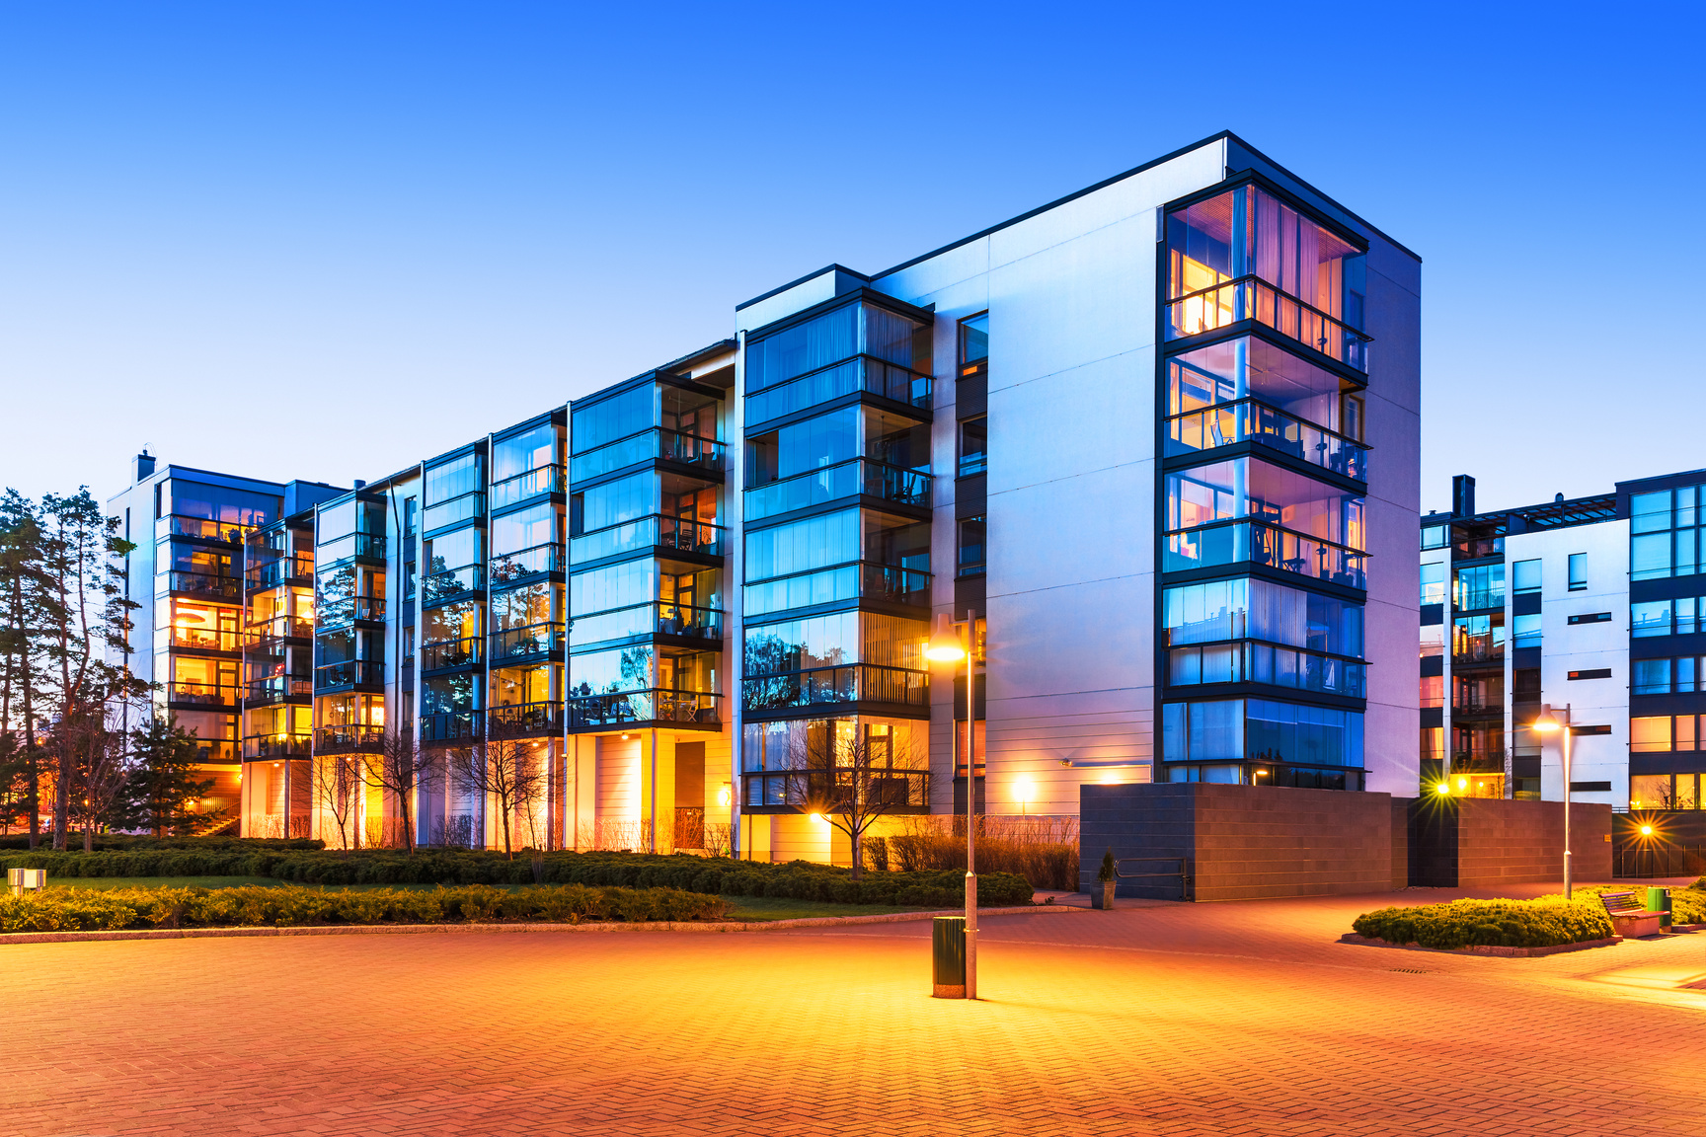

Thank You

